Slide 1
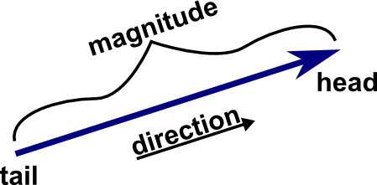
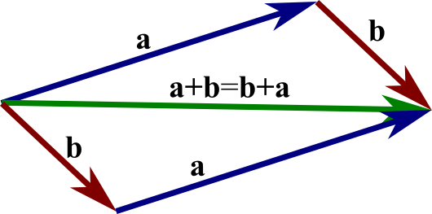
Vector Operations
(YAY! Vectors! ☺)

Slide 2
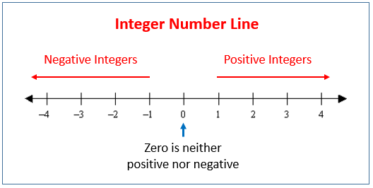
Vectors
Vectors are mathematical representations of quantities that have both magnitude and direction. Technically, even the numbers we use to count are vectors on the number line (with the number being the distance from 0, and the direction being + or - ).

Slide 3
Vector Operations
Vectors can be added tip-to-tail. Determining the magnitude & direction generally involves trigonometric techniques such as Pythagoras, SOH CAH TOA, cos rule, sine rule, co-interior angles, alternate angles, etc.
Subtracting vectors can be done using the same technique (only you ‘add’ the negative of the vector you wish to subtract). This is useful when you are asked to find the ‘difference’ or ‘change in’ vector quantities i.e. for an object changing velocity, the change in velocity can be found by subtracting the initial velocity from the final velocity.

Slide 4
Vector Operations
A
+
B
=
A+B
A
-
=
A-B
B
Notes:
Chair & Rope Demo

Slide 5
Vector Operations
The key to solving vector problems is DRAW LABELLED DIAGRAMS! Quite often it is useful to draw multiple diagrams for the same problem, and that’s okay (in fact, it’s often necessary).
When drawing diagrams, you can only add or subtract vectors of the same type – you cannot mix them up! (i.e. you cannot put a velocity vector into a diagram containing displacement vectors).
Let’s try some examples (SET 1, Q3,4,8,13,23).
Notes:
Skip Q21 until we’ve covered inclined planes.

Slide 6
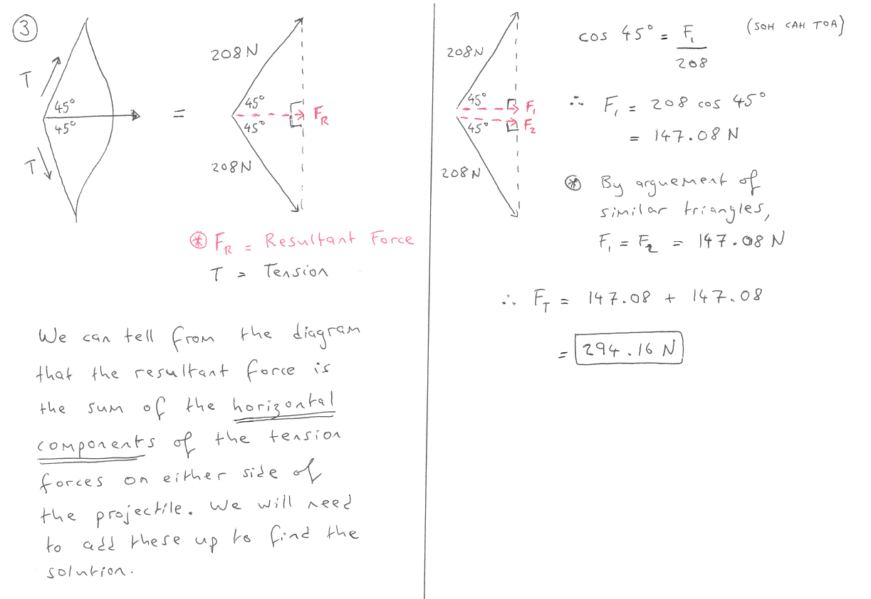


Slide 7
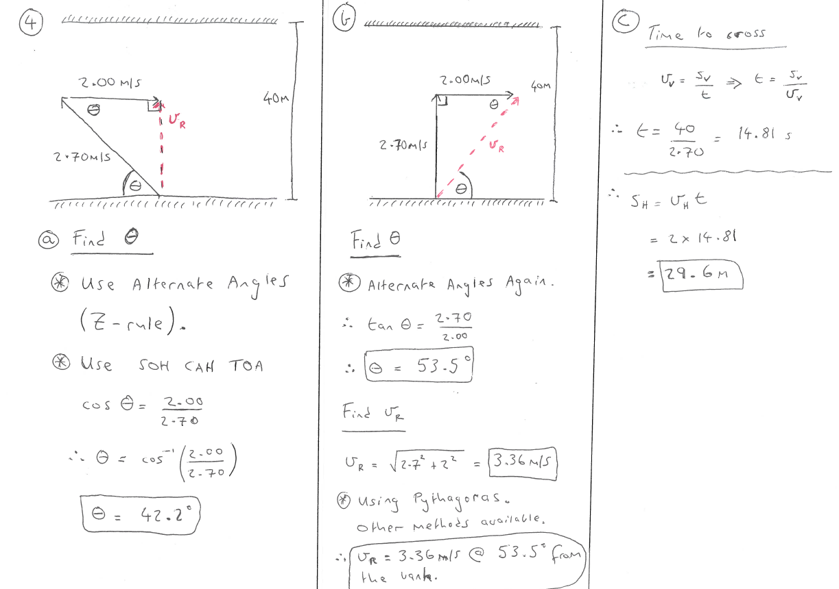
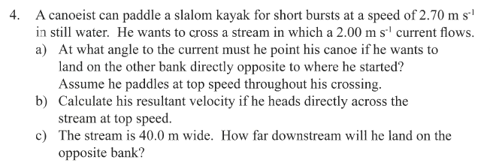

Slide 8
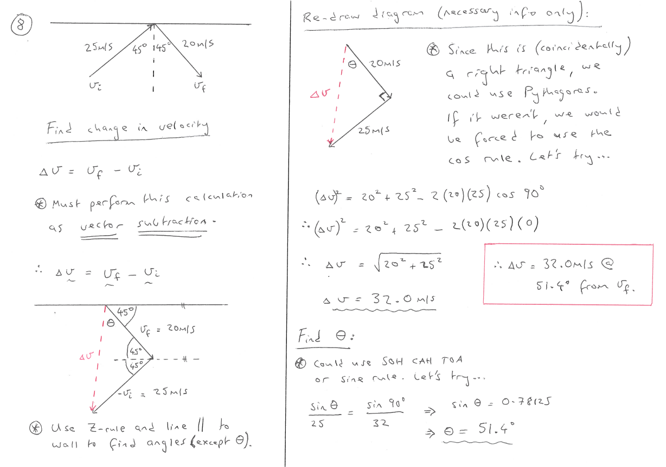


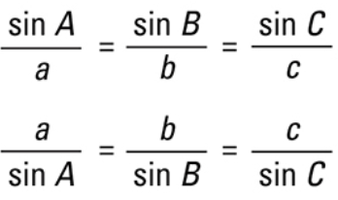

Slide 9
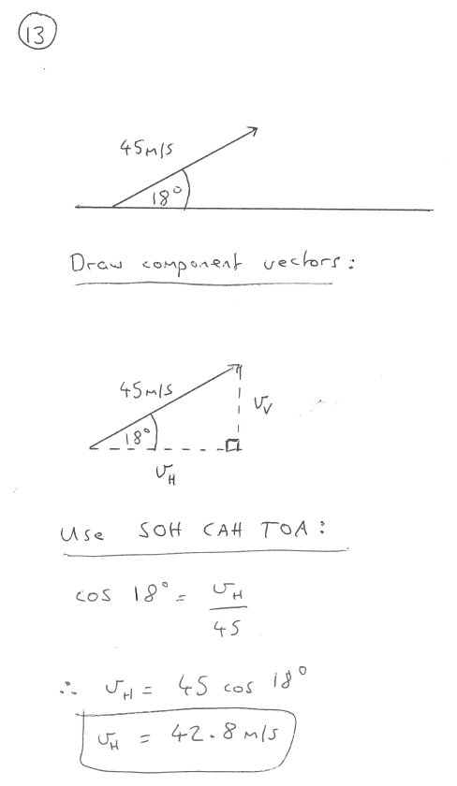

Slide 10
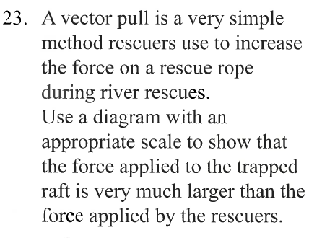
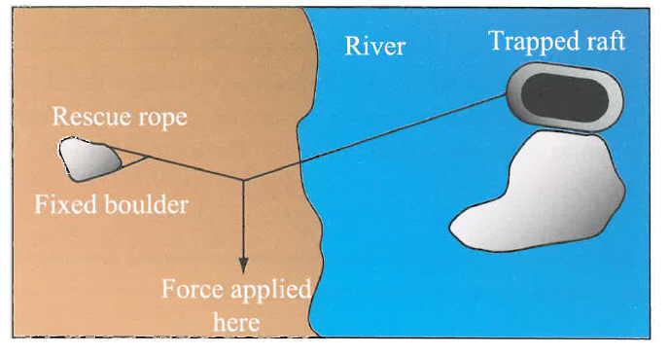



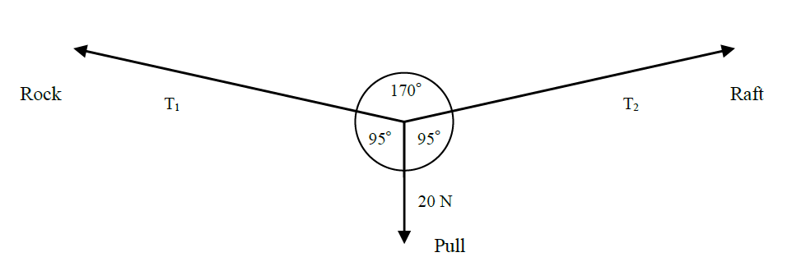
Questions like this can be a bit tricky… we’re not given any numbers. However, we are given enough information that we can make some reasonable estimates as to the forces/angles involved, which allows us to get an idea of the ‘force applied here’ and how it compares to the force on the raft, so let’s try that…
We can see that the force on the raft (T₂) is greater that the ‘force applied here’ of 20 N, therefore we have proof of concept.
QED
Notes:
This one is tricky to explain as presented – however, it is a brilliant lead in to equilibrium (next topic). ∑F_{up} = ∑F_{down} , ∑F_{left} = ∑F_{right}

